Slide 1

Support Vector Machine - Math
Presented by:
Elizer Ponio Jr.
Department of Computer Science
College of Computing and Information Technologies

Slide 2
Outline
Equation of the line and the General Form
Hard Margin SVM
Soft Margin SVM

Slide 3
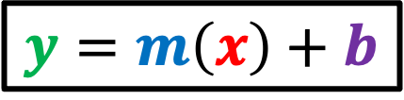
$$y=m\left(x\right)+b$$
Usually, we express the equation of a straight line like this, which is called the slope-intercept line form because the equation contains information about the slope and intercept of the line.
Snout Width
Size

Slide 4

$$y=m\left(x\right)+b$$
For example, this line is expressed as
$$y=0.5\left(x\right)+1$$
Snout Width
Since it intercepts the y-axis at 1 and has a slope of 0.5
Size

Slide 5

$$y=m\left(x\right)+b$$
If $m$ is zero and $b$ is 3, the line is expressed as
$$y=0\left(x\right)+3$$
$$y=3$$
Snout Width
Size

Slide 6
$$y=m\left(x\right)+b$$
How about this vertical line?
Snout Width
Size

Slide 7
$$y=m\left(x\right)+b$$
It turns out that that this form of equation cannot be used to describe a vertical line because the slope would be infinitely large
Snout Width
Size

Slide 8
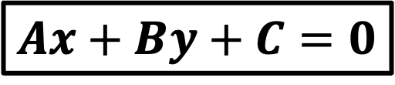
$$y=m\left(x\right)+b$$
This is one reason why we need to use the so-called “general form” of the equation for a straight line
Snout Width
$$Ax+By+C=0$$
Size

Slide 9
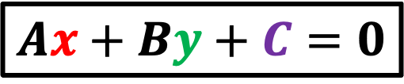
$$y=m\left(x\right)+b$$
$$Ax+By+C=0$$
Since vertical lines can be used to separate data points of two classes, the slope-intercept form to describe the line is not appropriate to use in SVM
Snout Width
Size

Slide 10
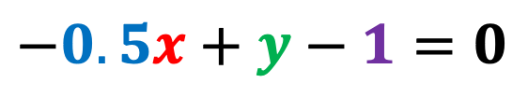
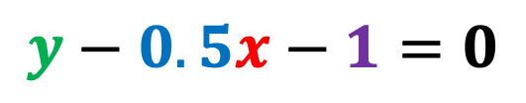
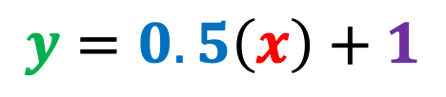
Suppose that we have the following line with a slope of 0.5 and intercept of one
$$y=0.5\left(x\right)+1$$
Snout Width
We will convert this equation to the general form
$$y−0.5x−1=0$$
$$−0.5x+y−1=0$$
Size

Slide 11
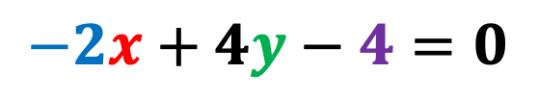
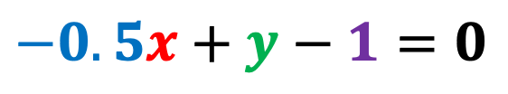
The coefficients are usually expressed as integers in this form
For example, if we multiply all terms by 4,
Snout Width
$$−0.5x+y−1=0$$
We get:
$$−2x+4y−4=0$$
Size

Slide 12
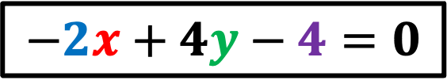
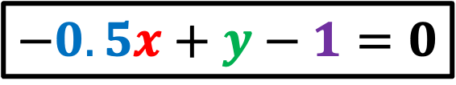
Both these equations describe the same line
$$−0.5x+y−1=0$$
Snout Width
$$−2x+4y−4=0$$
Size

Slide 13
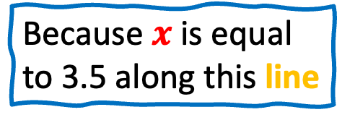

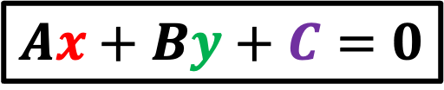
$$Ax+By+C=0$$
By using the general form, we can now describe the vertical line like this
Snout Width
$$x−3.5=0$$
Because $x$ is equal to 3.5 along this line
Size

Slide 14
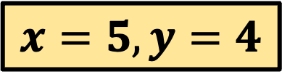
$$Ax+By+C=0$$
Another nice feature of the general form is that it can tell us which side of the line a data point is located on.
$$x=5,y=4$$
Snout Width
Size

Slide 15


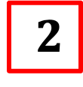

If we plugin the x and y coordinates of this data point in our equation,
$$x=5,y=4$$
Snout Width
$$−2x+4y−4=0$$
$$−2\left(5\right)+4\left(4\right)−4=0$$
$$−10+16−4=$$
$$2$$
Size

Slide 16
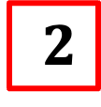
$$−10+16−4=$$
$$2$$
We see that it results in a value greater than zero, which in case means that the data point is above the line
$$x=5,y=4$$
Snout Width
Size

Slide 17


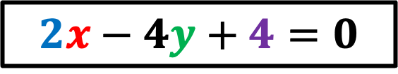
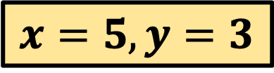
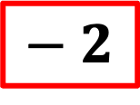
In comparison, this data point results in a negative value which tells us that the data point is below the line.
Snout Width
$$2x−4y+4=0$$
$$−2\left(5\right)+4\left(3\right)−4=0$$
$$x=5,y=3$$
$$−10+12−4=$$
$$− 2$$
Size

Slide 18
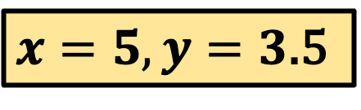


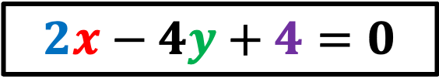

Note that any data point on the line will result in a value of zero
$$2x−4y+4=0$$
Snout Width
$$−2\left(5\right)+4\left(3.5\right)−4=0$$
$$−10+14−4=$$
$$0$$
$x=5,y=3$.5
Size

Slide 19
Outline
Equation of the line and the General Form
Hard Margin SVM
Soft Margin SVM

Slide 20
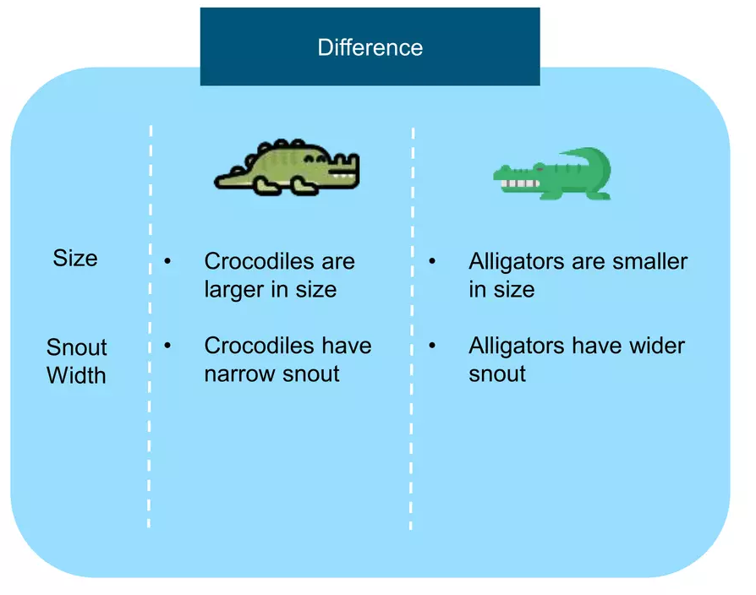
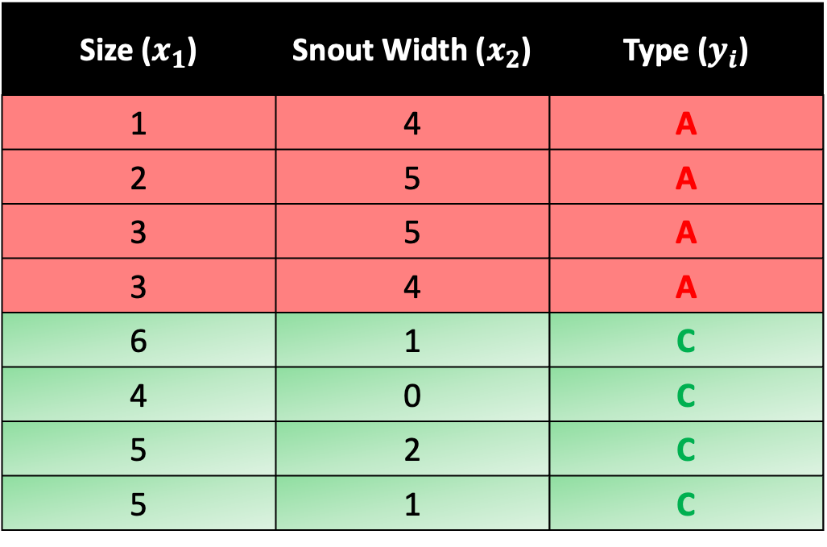
Size ($x_{1}$) | Snout Width ($x_{2}$) | Type ($y_{i}$)
1 | 4 | A
2 | 5 | A
3 | 5 | A
3 | 4 | A
6 | 1 | C
4 | 0 | C
5 | 2 | C
5 | 1 | C

Slide 21
Snout Width
Size

Slide 22

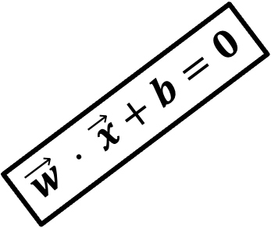
Assume we train an SVM on this dataset and find the optimal weight vector $\vec{w}$ to separate the classes.
Let’s say the resulting weight vector is:
$$\vec{w}= \left[\begin{aligned}−0.5 \\ 0.5\end{aligned}\right]$$
$$\vec{w} ⋅ \vec{x}+b=0$$
Snout Width
Size

Slide 23
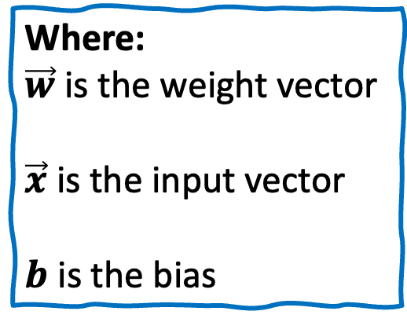
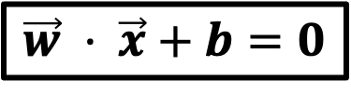
We can get the equation of our decision boundary using the form
$$\vec{w} ⋅ \vec{x}+b=0$$
$$\vec{w} ⋅ \vec{x}+b=0$$
Snout Width
Where:
$\vec{w}$ is the weight vector
$\vec{x}$ is the input vector
$b$ is the bias
Size

Slide 24
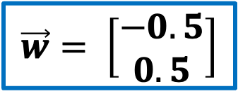



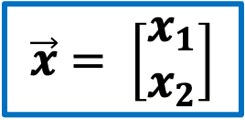
If we do the math..
$$\vec{w} ⋅ \vec{x}+b=0$$
$$\vec{w} ⋅ \vec{x}+b=0$$
$$\vec{w}= \left[\begin{aligned}−0.5 \\ 0.5\end{aligned}\right]$$
Snout Width
$$\vec{x}= \left[\begin{aligned}x_{1} \\ x_{2}\end{aligned}\right]$$
$$b=0.5$$
We get
$$−0.5x_{1}+0.5x_{2}+0.5=0$$
Size

Slide 25
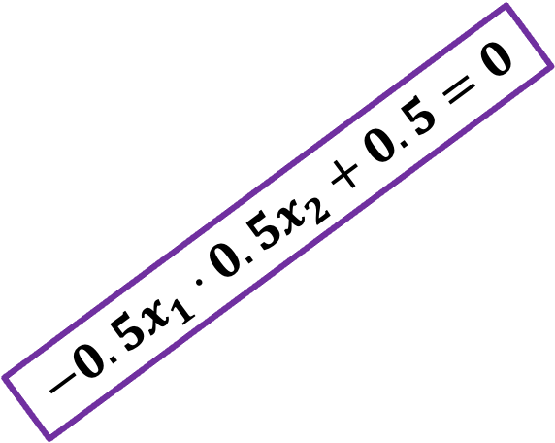

$$−0.5x_{1}+0.5x_{2}+0.5=0$$
This is the equation of the decision boundary or hyperplane
$$−0.5x_{1}⋅0.5x_{2}+0.5=0$$
Snout Width
Size

Slide 26
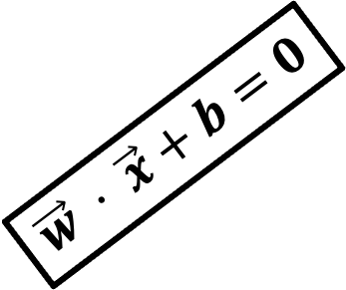
Next, we need to draw two parallel lines above and below the hyperplane.
It is like creating a highway or a street between our two classes.
$$\vec{w} ⋅ \vec{x}+b=0$$
Snout Width
Size

Slide 27
These two parallel lines defines the boundary of our ”highway” or ”street”
$$\vec{w} ⋅ \vec{x}+b=0$$
Snout Width
Size

Slide 28


Notice that our support vectors touches the boundary of our “street”
$$\vec{w} ⋅ \vec{x}+b=0$$
Snout Width
Support Vector
Support Vector
Size

Slide 29
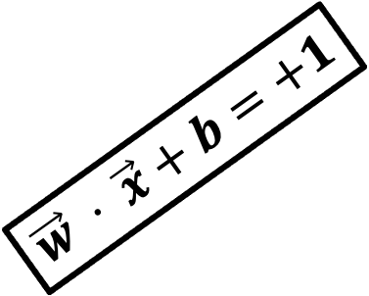
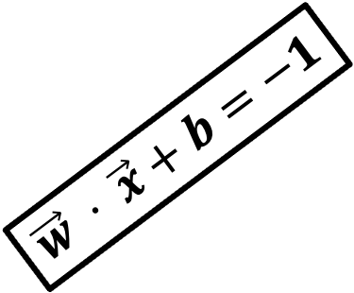
$$\vec{w} ⋅ \vec{x}+b=+1$$
These two parallel lines that define the boundary of our ”highway” are formed using these equations
$$\vec{w} ⋅ \vec{x}+b=0$$
Snout Width
Support Vector
$$\vec{w} ⋅ \vec{x}+b=−1$$
Support Vector
Size

Slide 30

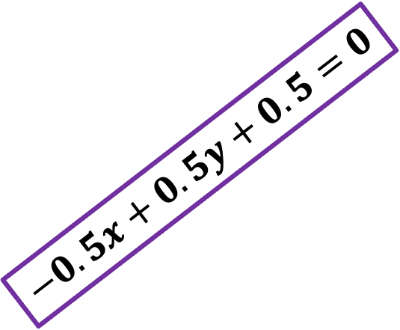
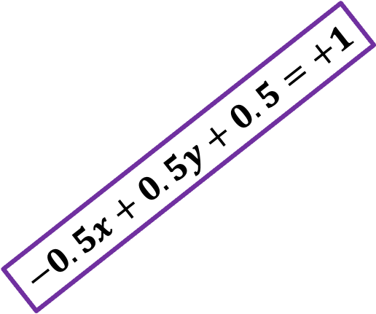
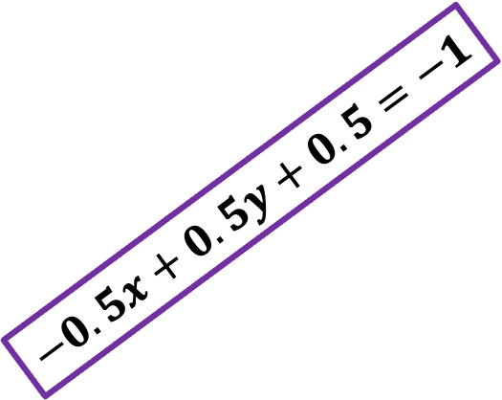


Thus, we will have the general form of all three lines
$$−0.5x+0.5y+0.5=+1$$
$$−0.5x+0.5y+0.5=0$$
Snout Width
$$−0.5x+0.5y+0.5=−1$$
$$−0.5x+0.5y+0.5=+1$$
$$−0.5x+0.5y+0.5=0$$
$$−0.5x+0.5y+0.5=−1$$
Size

Slide 31
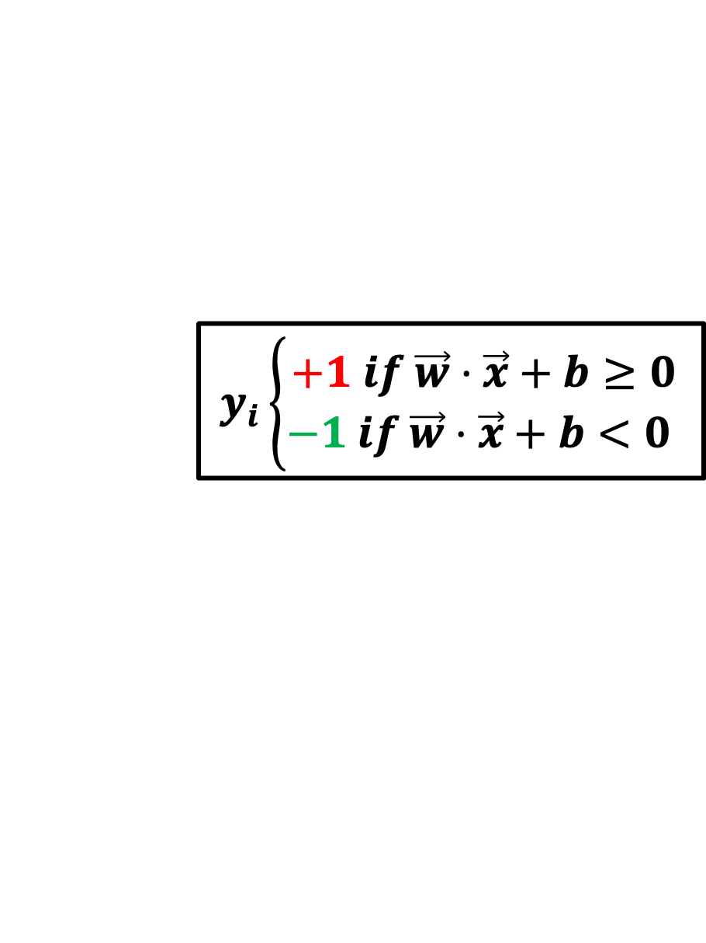
Classification in SVM is usually defined like this:
Snout Width
$$y_{i}\left\{\begin{aligned}+1 if \vec{w}⋅\vec{x}+b≥0 \\ −1 if \vec{w}⋅\vec{x}+b<0 \end{aligned}\right.$$
Size

Slide 32


$$y_{i}\left\{\begin{aligned}+1 if \vec{w}⋅\vec{x}+b≥0 \\ −1 if \vec{w}⋅\vec{x}+b<0 \end{aligned}\right.$$
We predict the class of a new sample to belong to the positive group if
$\vec{w}⋅\vec{x}+b$ is greater than or equal to 0
Snout Width
Size

Slide 33
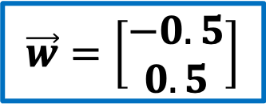



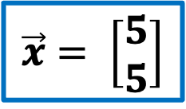
$$y_{i}\left\{\begin{aligned}+1 if \vec{w}⋅\vec{x}+b≥0 \\ −1 if \vec{w}⋅\vec{x}+b<0 \end{aligned}\right.$$
For example, if
Snout Width
$$\vec{w}=\left[\begin{aligned}−0.5 \\ 0.5\end{aligned}\right]$$
$$\vec{x}= \left[\begin{aligned}5 \\ 5\end{aligned}\right]$$
$$b=0.5$$
$$−0.5\left(5\right)+0.5\left(5\right)+0.5$$
$$=0.5$$
Size

Slide 34
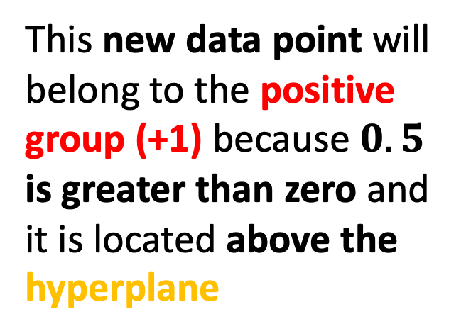
$$y_{i}\left\{\begin{aligned}+1 if \vec{w}⋅\vec{x}+b≥0 \\ −1 if \vec{w}⋅\vec{x}+b<0 \end{aligned}\right.$$
This new data point will belong to the positive group (+1) because $0.5$ is greater than zero and it is located above the hyperplane
Snout Width
Size

Slide 35

$$y_{i}\left\{\begin{aligned}+1 if \vec{w}⋅\vec{x}+b≥0 \\ −1 if \vec{w}⋅\vec{x}+b<0 \end{aligned}\right.$$
We predict the class of a new sample to belong to the negative group (-1) if $\vec{w}⋅\vec{x}+b$ is less than 0
Snout Width
Size

Slide 36


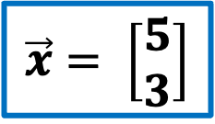
$$y_{i}\left\{\begin{aligned}+1 if \vec{w}⋅\vec{x}+b≥0 \\ −1 if \vec{w}⋅\vec{x}+b<0 \end{aligned}\right.$$
For example, if
Snout Width
$$\vec{w}=\left[\begin{aligned}−0.5 \\ 0.5\end{aligned}\right]$$
$$\vec{x}= \left[\begin{aligned}5 \\ 3\end{aligned}\right]$$
$$b=0.5$$
$$−0.5\left(5\right)+0.5\left(3\right)+0.5$$
$$=−0.5$$
Size

Slide 37

$$y_{i}\left\{\begin{aligned}+1 if \vec{w}⋅\vec{x}+b≥0 \\ −1 if \vec{w}⋅\vec{x}+b<0 \end{aligned}\right.$$
This new data point will belong to the negative group (-1) because $−0.5$ is less than zero and it is located below the hyperplane
Snout Width
Size

Slide 38
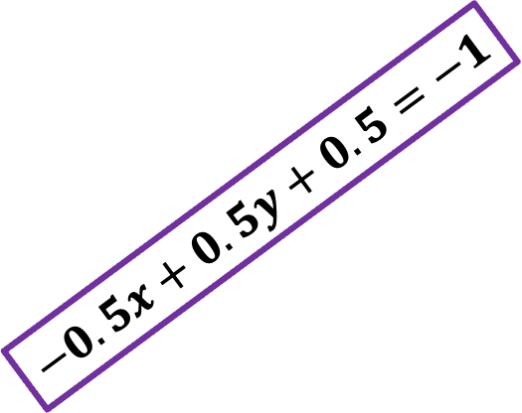
In SVM, if there is a decision boundary that can separate the two classes completely, SVM tries to find the optimal values of A and B so that the distance between the two yellow broken lines are maximized
$$−0.5x+0.5y+0.5=+1$$
Snout Width
$$−0.5x+0.5y+0.5=−1$$
Size

Slide 39

We can calculate the distance between two parallel lines with this equation
Snout Width
$$d= \frac{|c_{2}−c_{1}|}{\sqrt{A^{2}+B^{2}}}$$
Size

Slide 40



$$d= \frac{|c_{2}−c_{1}|}{\sqrt{A^{2}+B^{2}}}$$
$$−0.5x+0.5y+0.5=+1$$
This equation of the distance between two parallel lines can be simplified to
Snout Width
$$−0.5x+0.5y+0.5=−1$$
$$d= \frac{2}{\sqrt{A^{2}+B^{2}}}$$
$$d= \frac{2}{|\left|w\right||}$$
Size

Slide 41





To compute the distance between our two broken lines, we must convert the equations of the lines to its standard form: $Ax+By+ C=0$
$$−0.5x+0.5y+0.5=+1$$
$$−0.5x+0.5y+0.5=+1$$
becomes
Snout Width
$$−0.5x+0.5y+0.5=−1$$
$$−0.5x+0.5y−0.5=0$$
and
$$−0.5x+0.5y+0.5=−1$$
becomes
$$−0.5x+0.5y+1.5=0$$
Size

Slide 42





$$d= \frac{|c_{2}−c_{1}|}{\sqrt{A^{2}+B^{2}}}$$
$$−0.5x+0.5y+0.5=+1$$
Positive boundary line:
$$−0.5x+0.5y−0.5=0$$
Snout Width
Negative boundary line:
$$−0.5x+0.5y+1.5=0$$
$$−0.5x+0.5y+0.5=−1$$
$$d= \frac{|1.5−(0.5)|}{\sqrt{{(−0.5)}^{2}+{(0.5)}^{2}}}$$
$$d=2.828$$
Size

Slide 43



$$d= \frac{2}{\sqrt{A^{2}+B^{2}}}$$
$$−0.5x+0.5y+0.5=+1$$
We can further rewrite $\sqrt{A^{2}+B^{2}}$ as the magnitude of w, which will give us the equation
Snout Width
$$−0.5x+0.5y+0.5=−1$$
$$d= \frac{2}{|\left|w\right||}$$
Size

Slide 44

$$d= \frac{2}{\sqrt{A^{2}+B^{2}}}$$
Training our SVM model can be defined as we try to find the optimal values of A and B of the hyperplane, so that we maximize the margin $d$
Snout Width
Size

Slide 45


Training our SVM model can be defined as we try to find the optimal values of A and B of the hyperplane, so that we maximize the margin $d$
Snout Width
Size
$$max \frac{2}{\sqrt{A^{2}+B^{2}}} such that \vec{w} ⋅ \vec{x}+b \left\{\begin{aligned}≥1 if y_{i}=+1 \\ ≤−1 if y_{i}=−1\end{aligned}\right.$$

Slide 46
Outline
Equation of the line and the General Form
Hard Margin SVM
Soft Margin SVM

Slide 47
In the real world, the datasets are typically not linearly separable.
In soft margin SVM we allow the model to misclassify some data points.
We penalize the model for such misclassification.
Snout Width
Size

Slide 48
To penalize our SVM model, we will use a loss function called the hinge loss
The key idea behind hinge loss is to penalize the model more when it misclassifies a sample that is closer to the decision boundary.
Snout Width
Size

Slide 49

The formula to calculate hinge loss is expressed as follows:
$$hingeloss=max(0, 1−y_{i}(\vec{w}\text{ ⋅ } \vec{x_{i}}−b))$$
Where:
$y_{i}$is the true label of the data point
$(\vec{w}\text{ ⋅ } \vec{x_{i}}−b)$ is the linear decision function that produces a score for a given input vector $\vec{x_{i}}$
$max⁡(0,1)$ensures that the loss is 0 if the data point is correctly classified and misclassified by a margin when the result is less than 1.

Slide 50

Let us calculate the hinge loss of a datapoint
Because datapoint is correctly classified as a crocodile in the negative group, there will be no penalty and thus will have a hinge loss of 0
Snout Width
Size

Slide 51






$$hingeloss=max(0, 1−y_{i}(\vec{w}\text{ ⋅ } \vec{x_{i}}−b))$$
$$hingeloss=max(0, 1−(−1)(−0.5\left(5\right)+0.5\left(1\right)−0.5))$$
$$hingeloss=max(0, 1−\left(−1\right)\left(−2.5\right))$$
Snout Width
$$hingeloss=max(0, 1−2.5)$$
$$hingeloss=max(0, −1.5)$$
$$hingeloss=0$$
Size

Slide 52

Let us now calculate the hinge loss of a datapoint
Because datapoint is misclassified as a crocodile in the negative group, there will be a penalty and thus will have a hinge loss greater than 0
Snout Width
Size

Slide 53





$$hingeloss=max(0, 1−y_{i}(\vec{w}\text{ ⋅ } \vec{x_{i}}−b))$$
$$hingeloss=max(0, 1−(+1)(−0.5\left(6\right)+0.5\left(2\right)−0.5))$$
$$hingeloss=max(0, 1(+1)\left(−2.5\right))$$
Snout Width
$$hingeloss=max(0, 1+2.5)$$
$$hingeloss=max(0, 3.5)$$
$$hingeloss=3.5$$
Size

Slide 54

Finally, let us calculate the hinge loss of a datapoint
Because datapoint is correctly classified as an alligator in the positive group but is in the margin, there will be a small penalty
Snout Width
Size

Slide 55





$$hingeloss=max(0, 1−y_{i}(\vec{w}\text{ ⋅ } \vec{x_{i}}−b))$$
$$hingeloss=max(0, 1−(+1)(−0.5\left(3\right)+0.5\left(2.5\right)−0.5))$$
$$hingeloss=max(0, 1(+1)\left(−0.75\right))$$
Snout Width
$$hingeloss=max(0, 1+0.75)$$
$$hingeloss=max(0, 1.75)$$
$$hingeloss=1.75$$
Size

Slide 56

Soft Margin SVM Equation
$$pick a vector w and intercept b such that the average hinge loss$$
$$\frac{1}{n}\sum_{i=1}^{n}{max⁡\text{ (0, 1− }y_{i}\text{ (}\vec{w}\text{ ⋅ } \vec{x_{i}}\text{ − }\text{b}\text{))}}+λ {\left\|\vec{w }\right\|}^{2}$$
$$is minimized while maximing the margin$$
$Lambda (λ)$ is a positive parameter which determines the trade off between increasing the margin size and ensuring that $\vec{x_{i}}$ lie on the correct side of the margin.

